Slide 1
Pollution Measurement from
Dust over Roadside Plant Leaf
Group members:
Angad Kumar (11700218108)
Sheikh Atib (11700218025)
Sagen Soren (11700118038)
Somu Raj (11700218017)
With the supervision of:
Dr. Hiranmoy Roy

Slide 2
Why is it Important to Measure Air Pollution?
According to a report published earlier by the World Health Organisation, air pollution kills approximately seven million people annually, worldwide. This accounts for as much as one in eight deaths, and is by far the single biggest environmental health risk.
In order to counteract this alarming statistic and take action to clean up air, it’s important to first understand where the pollution is most concentrated.

Slide 3
Our Solution
There are many solutions to Air pollution. But actions at the individual and community level are also important.
So, we have decided to measure the pollution level first.
In order to measure the pollution nearby, we decided to scan the dust over the road side plant leaf.
Collecting big Dataset (pictures of leaves).
Dividing Dataset into test,trained and Value section each containing three subfolders(Dust_image,Less_Dust_image,Normal_image).
Preprocess the Dataset.
Model building.
Train dataset.
Model performance evaluation.

Slide 4
Required Tools
Python
Keras
Google colab
A Dataset
Technique
DNN ( Deep Neural Network)
CNN (Convolutional Neural Network)

Slide 5
Our Approach
In order to do this,
Firstly, we need to have a dataset of at least 500 pictures, so that it can be augmented to a huge dataset.
For coding part, we need to import various libraries in python such as
Numpy for working with arrays,
Os for accessing directories,
Pandas for manipulating data,
Matplot for visualization or plotting the data into graph.
For model Building import Sequential model from keras Library.
Import required dataset and plot the images.
Augmenting them for creating new data and model them using adam optimizer (for minimizing objective function).
Then train the sequential model to reach to a result.

Slide 6
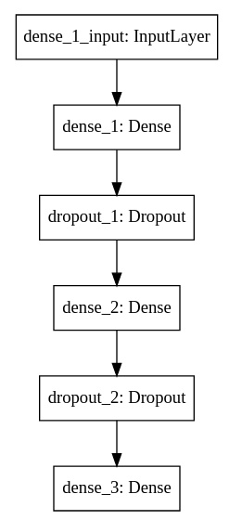
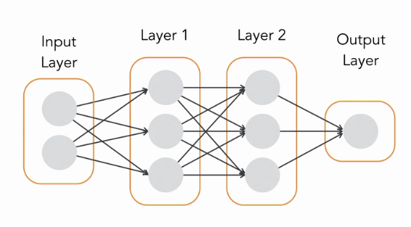
Sequential Model

Slide 7
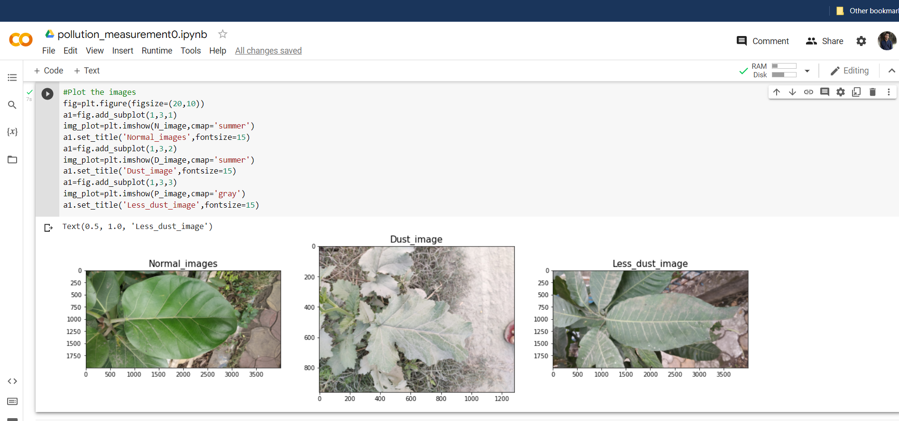
Graph plotting of dataset

Slide 8
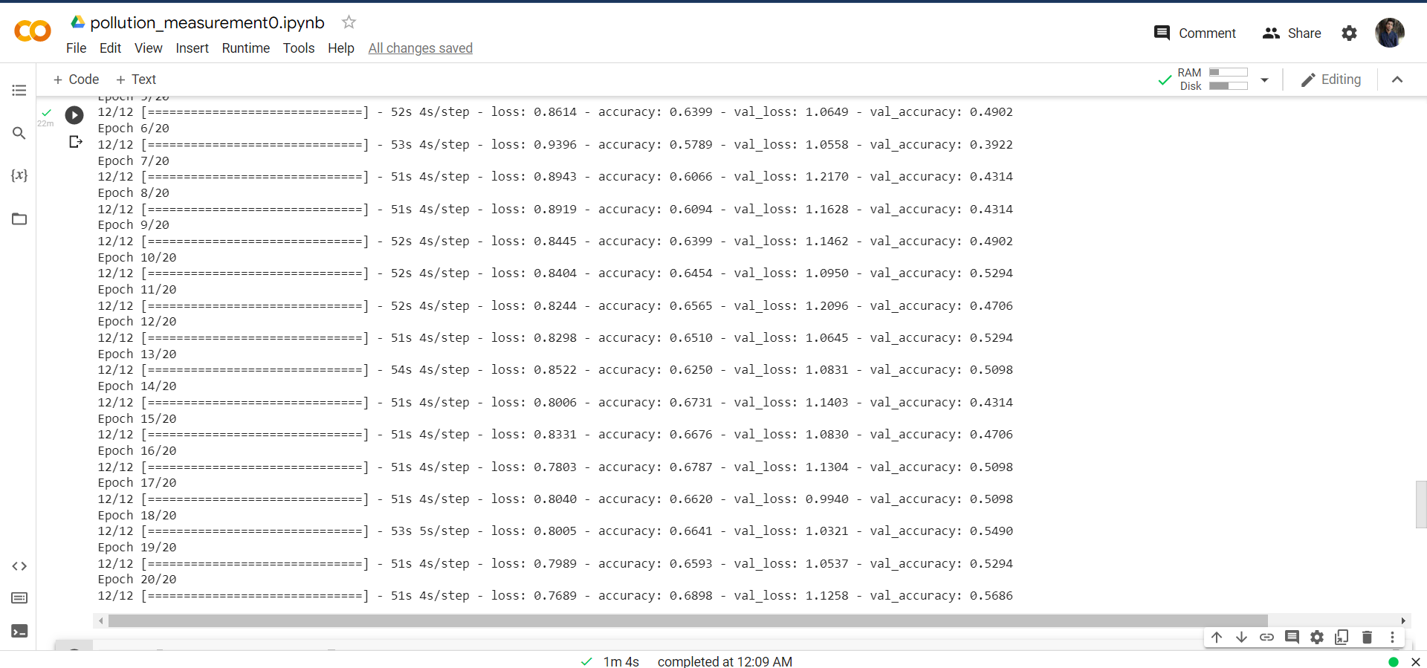
Result
Max. accuracy we have achieved is 92% till now.

Slide 9
References
A report by WHO on air pollution.
Air pollution 'kills 7 million people a year' | Pollution | The Guardian
Fundamentals of Deep Learning.
Various Educational Videos.
Neural Networks and Deep learning by Andrew Ng

Slide 10
Thank You
Special Thanks: Dr. Hiranmoy Roy

